Slide 1
TECHGROUND HACKATHON #3 PITCH DECK
LUXOFT
Team #14 – AVVAO

Slide 2

ABOUT US
Alex-Taylor Danko - FE+BE dev - 2y of exp. Vitalii Tymashkov - Solutions Architect - 10+ years of exp. Vira Vakhovska - FE dev - 3.5 month internship A... (left)
Oleksandra Skliar - UI/UX - 1year of exp.

Slide 3
SOLUTION
USER INTERFACE
BENEFITS
User can interact with the chat-bot by different channels: 1) iFrame window in the browser.
2) Native app and/or web-UI
2.1) Telegram
2.2) Viber
2.3) Facebook messenger
Chat-bot makes it easier to help veterans.
Aggregated data are available in the admin console
EASY TO DEPLOY AND USE
TARGET AUDIENCE
Simple design gives end-users the targeted information they need
System is easy to deploy within original website ecosystem.
Veterans of war
Family members of veterans
People who do support veterans and family members
System administrators
System analysts
Providers of services to veterans

Slide 4
PRODUCT BENEFITS
Creative ideas included in the project:
Chatbot working in browser of an existing website – to make it easier to start communicating.
Option for changing chat-bot applications preserving the context of the discussion (start in browser of website and switch to telegram). Available only for registered users. Planned in the later releases.
Option to have a relax zone (meditation zone) – quick switch to digital-space with relax music/video – to meditate. Planned in the later releases.
Recognition of the end-user’s tone of voice to offer psychological help. Planned in the later releases.
Telegram chatbot has the “Posttraumatic stress disorder (PTSD) self-assessment scale. PCL-5 methodology”.

Slide 5
PRODUCT OVERVIEW
NFRS and QUALITY ATTRIBUTES
New solution should follow the following NFRs:
Usability - should consider people with usual abilities and with disabilities (may vary).
Performance – should be enough to serve up to 1M of users in total, response time of bot should be less than 3 seconds for ordinary queries, and up to 10 seconds for complex queries (including time for writing the response).
Scalability – should be enough to scale from 1 concurrent user up to max – 1000 concurrent users.
Max number of concurrent users – 1000 persons for all services.
Deployability – solution should allow simple hosting on the same infrastructure as the existing solution. No migration between clouds is considered.
System availability – should be on the SLA 99% initially, increased to 99.9%.
Integration – solution should be easy to integrate with existing solutions and 3rd parties.
Security – system should encrypt all data at rest and in transit. No PII should be exposed without 2FA authentication.

Slide 6
PRODUCT OVERVIEW
INTERFACE
New solution should have the following interface:
For end-users:
iFrame window - which will be included to the existing website.
Chats in messaging services – the chatbot should be integrated to the Telegram, Viber, FB messenger, so it can be opened in the native mobile applications or on Web-UI version (with responsive design of the messaging service).
For admin users: App Admin interface – is a responsive web-UI application on Next.js. Should contain features on separate pages for data exporting, analytics, segmentation, access rights, content management, etc.
For system administrators:
System administration – is considered with cloud vendors tools / consoles. Monitoring should be done with open-source tools.
Deployment of application - should be considered with GitHub features – repo, actions, deploy.
Administration of 3rd party integrations – should be considered with their admin tools. Payments management should be included also.

Slide 7
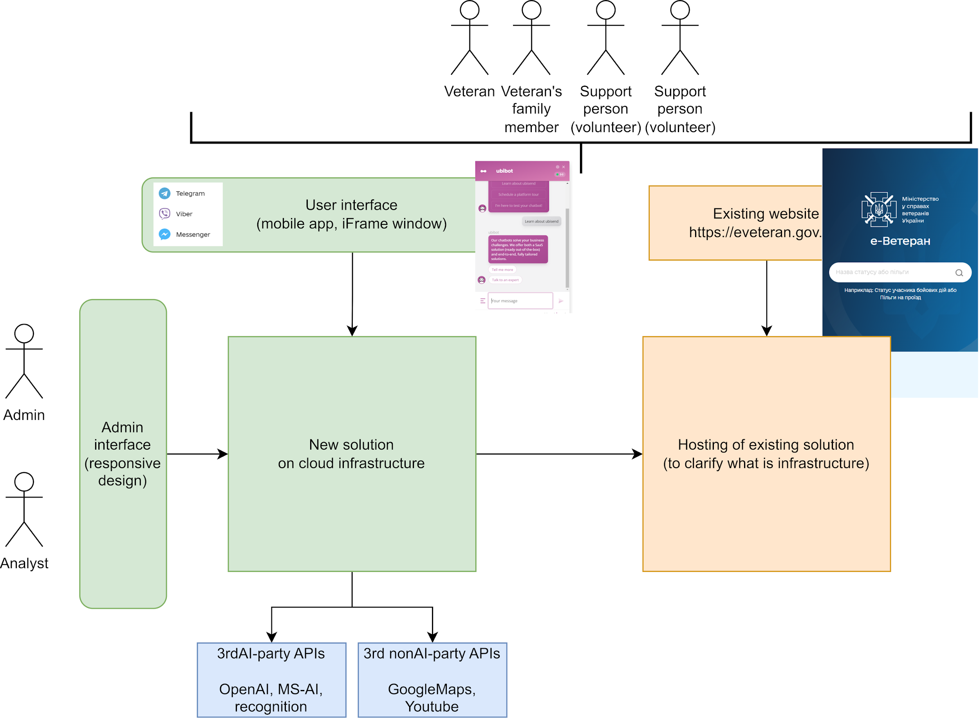
SOLUTION ARCHITECTURE - CONTEXT VIEW

Slide 8
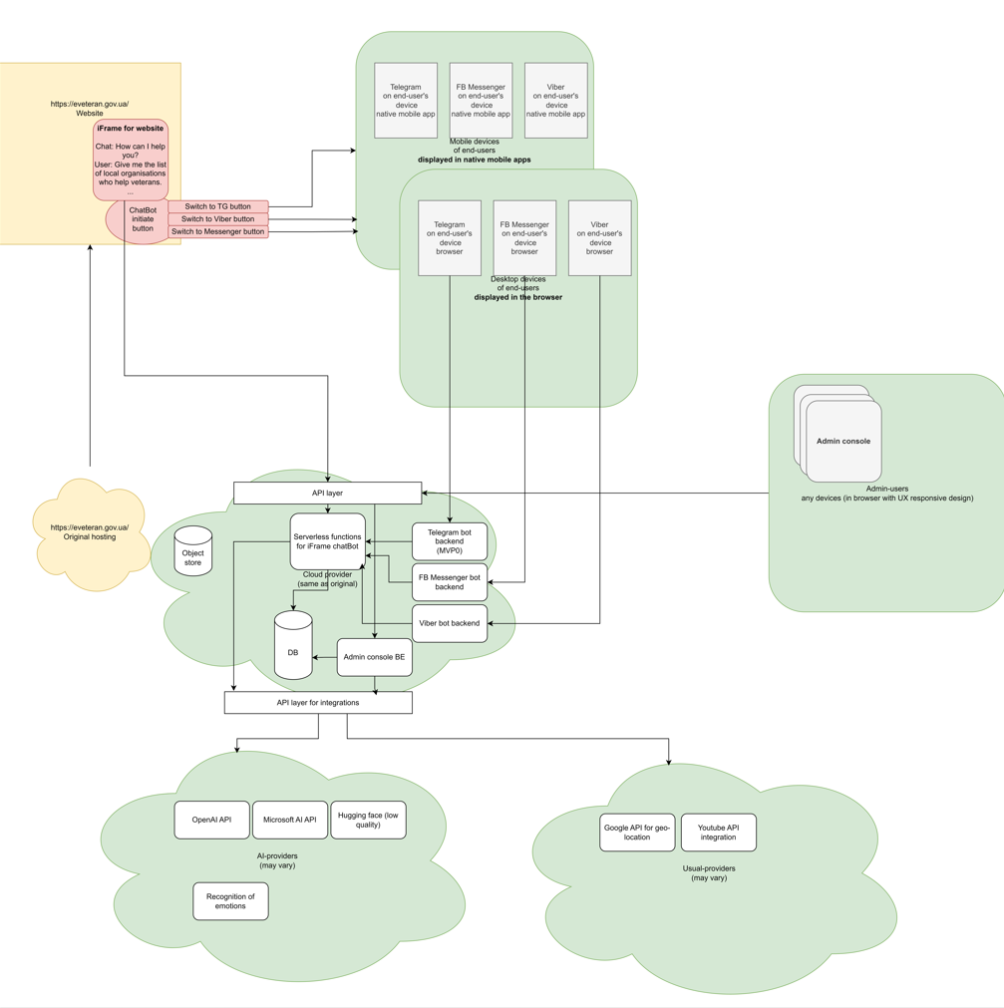
SOLUTION ARCHITECTURE - COMPONENT VIEW
CLOSE THE GAP
Our product makes consumer lives easier, and no other product on the market offers the same features
TARGET AUDIENCE
Gen Z (18-25 years old)

Slide 9
UI/UX WORKFLOWS
WHICH WERE COVERED
According to the request there is the list of workflows which were covered in UX:
1. Creation and management of user segments
2. Working with analytics
The administrative panel for the "e-Veteran" chatbot should also include the following analytical functions for collecting and displaying information:
1. Analysis of subscribers by type of status in the addressed:
2. Analysis of user groups:
3. Tracking user activity (attendance) for the selected period.
Variations of analytical queries:
Tracking the number of open tips per period, broken down by messenger type and tip type.
Analysis of user activity in terms of periods and types of messengers.

Slide 10
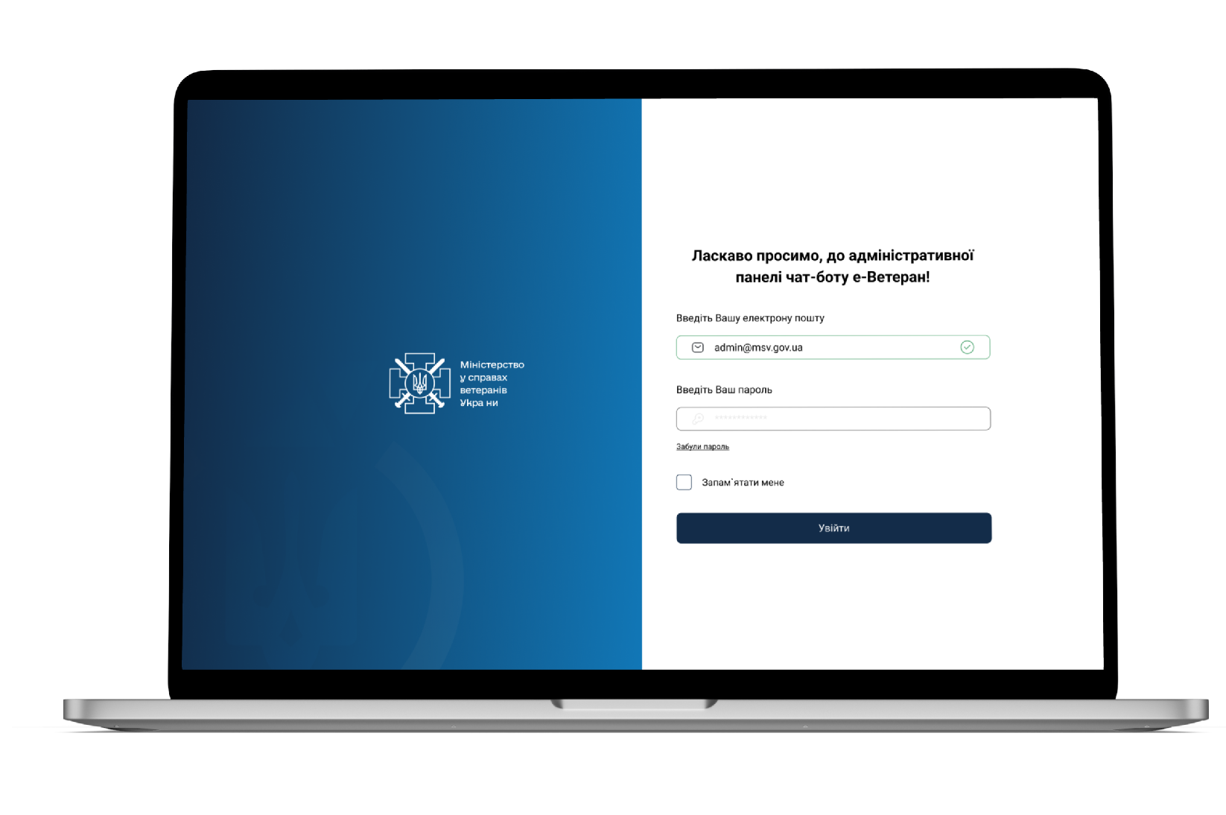
UI/UX OVERVIEW
ADMIN PANEL
The page for administrator login to the dashboard.
Login is carried out using a login and password, and it is also possible to reset the password.
Notes:
1. Аналіз підписників за типом статуса у звернені:
Фіксування кількості усього звернень.
Відстеження кількості юзерів по областям.
Відстеження кількості найчастіших питань.
2. Аналіз груп користувачів:
Відстеження кількості користувачів в кожній з утворених адміном груп.
3. Відстеження активності користувачів (відвідуваність) за обраним періодом.
Сегментація користувачів за періодами активності, такими як 7 днів, 14 днів, 21 день, 1 раз в місяць, 1 раз в три місяці,.
Фіксування активності користувачів (наприклад, кількість відвідувань) виходячи з обраного періоду.
Варіації аналітичних запитів:
Адміністратор повинен мати можливість обирати період для аналізу та групувати дані відповідно до зазначених параметрів, таким чином:
Відстеження кількості відправлених порад за період (наприклад, за тиждень, місяць, рік) з вказанням типу поради та месенджера.
Відстеження кількості відкритих порад за період з розподілом за типом месенджера та типом поради.
Аналіз активності користувачів в розрізі періодів та видів месенджерів.
Аналіз активності користувачів в розрізі періодів та видів месенджерів.
Ці аналітичні дані повинні бути доступні адміністраторам через інтерфейс адміністративної панелі та можуть бути експортовані в ексель-файл для подальшого аналізу.

Slide 11
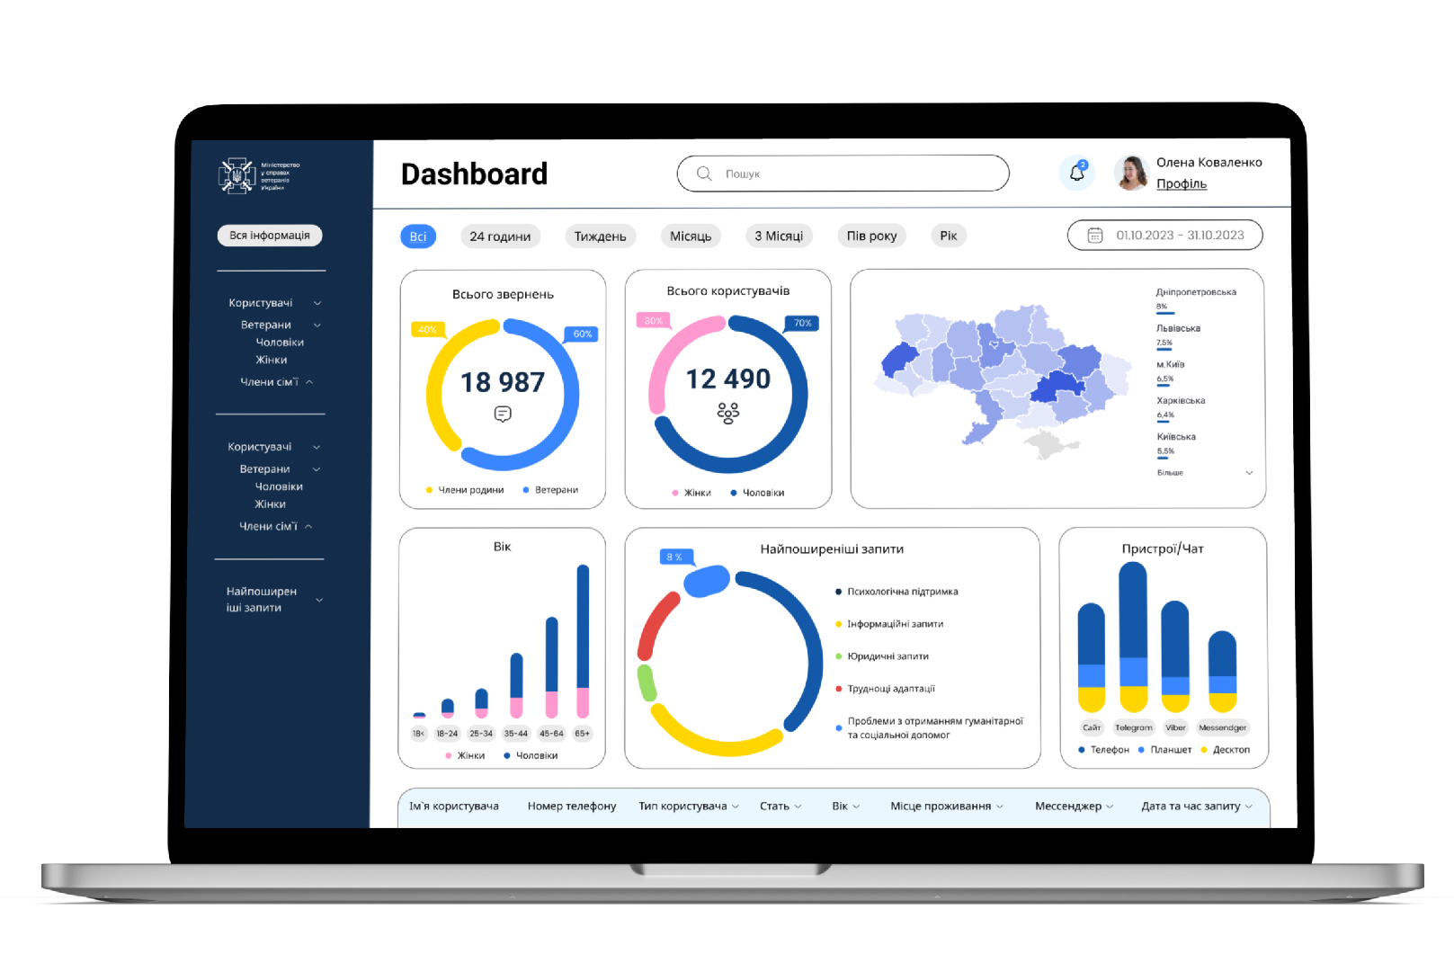
Dashboard- Home Page
The dashboard on the administrative panel provides the following key insights:
Number of inquiries, segmented into veterans and family members.
Number of individuals who have inquired, categorized by gender.
Regional distribution of inquiries.
Age demographics.
Frequently asked questions.
Messenger and device usage details.
User table with filtering capabilities.
Navigational sidebar for quick access to various sections.
Link for exporting the table to Excel.

Slide 12
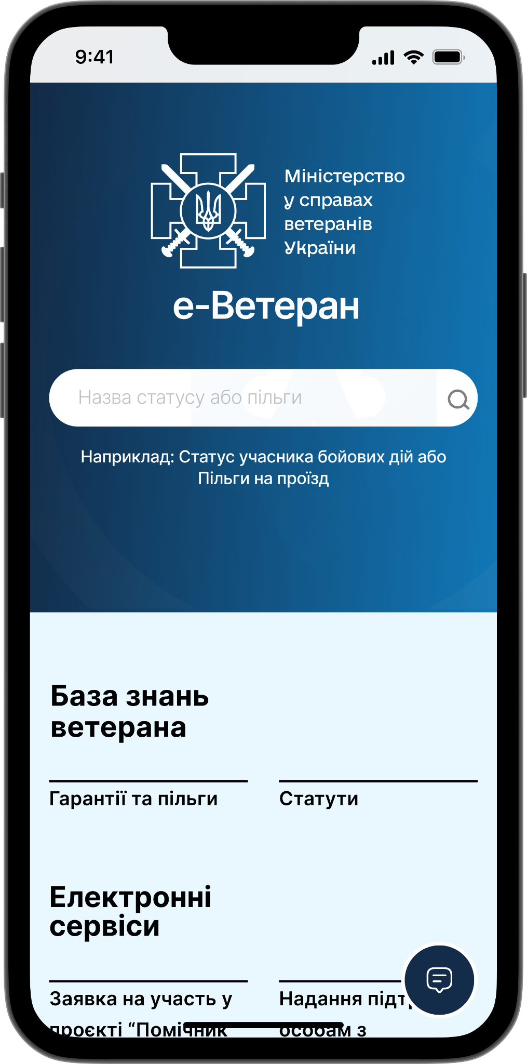
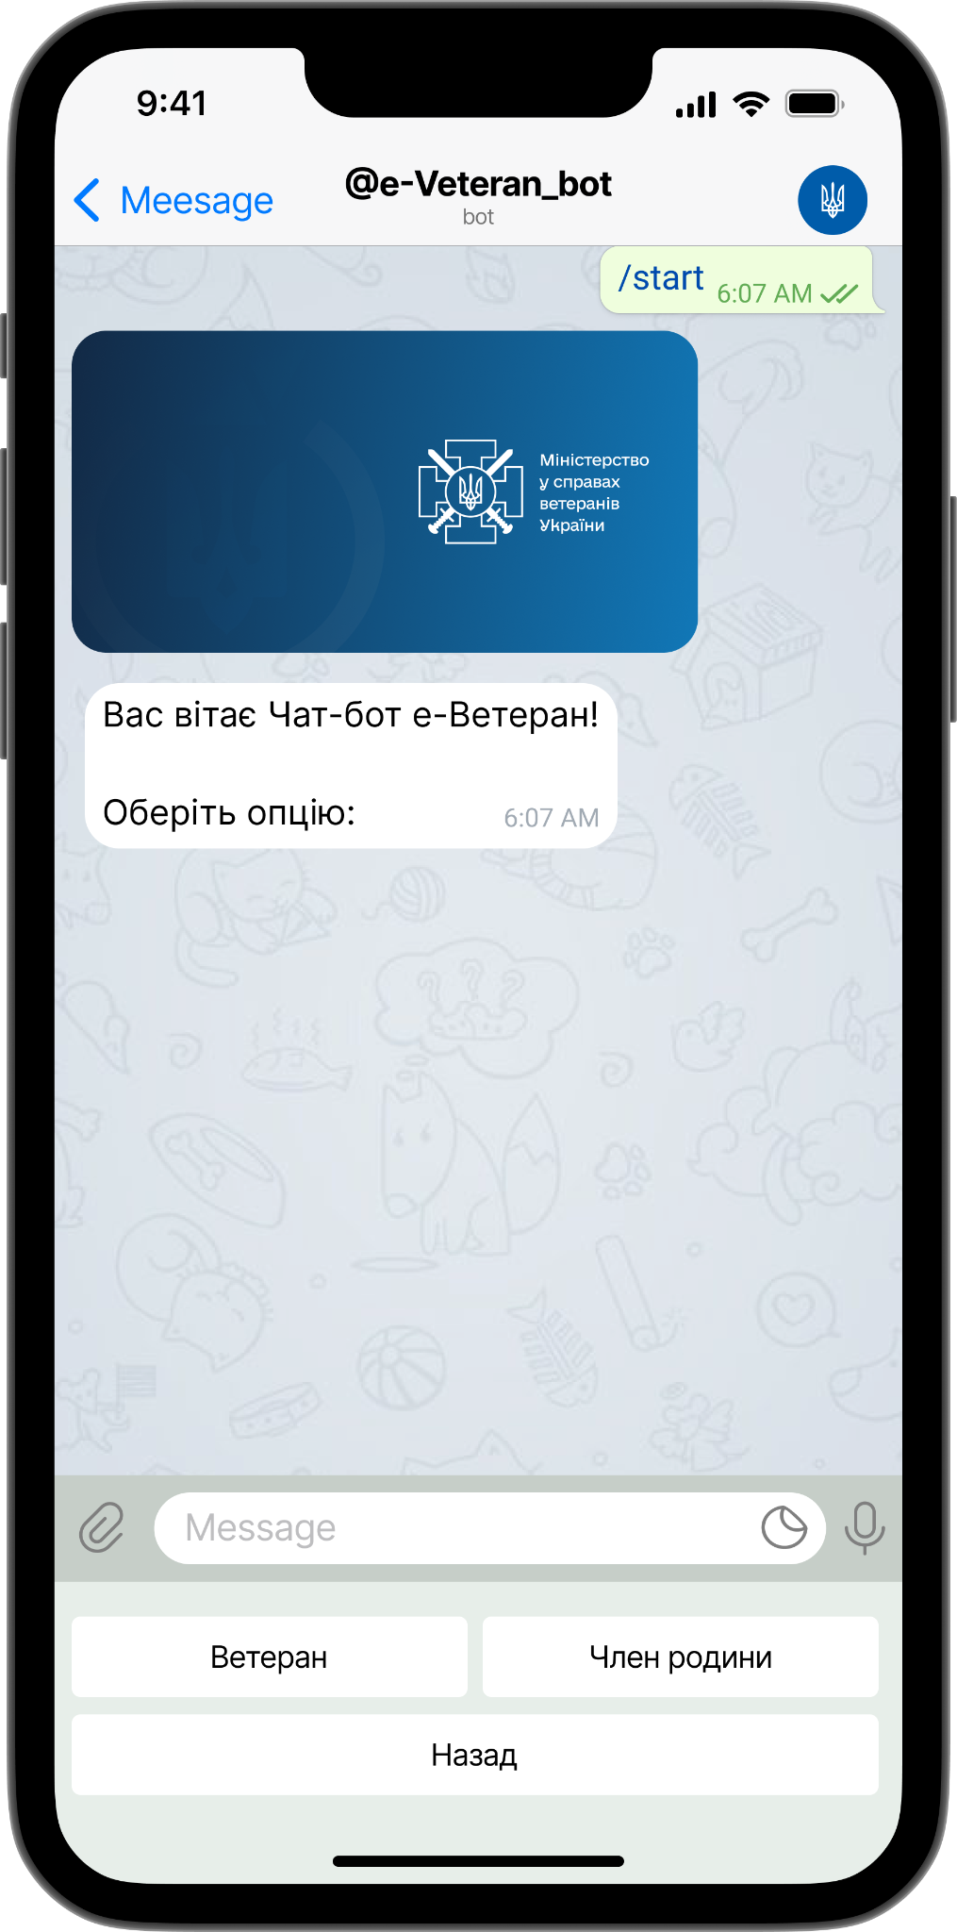
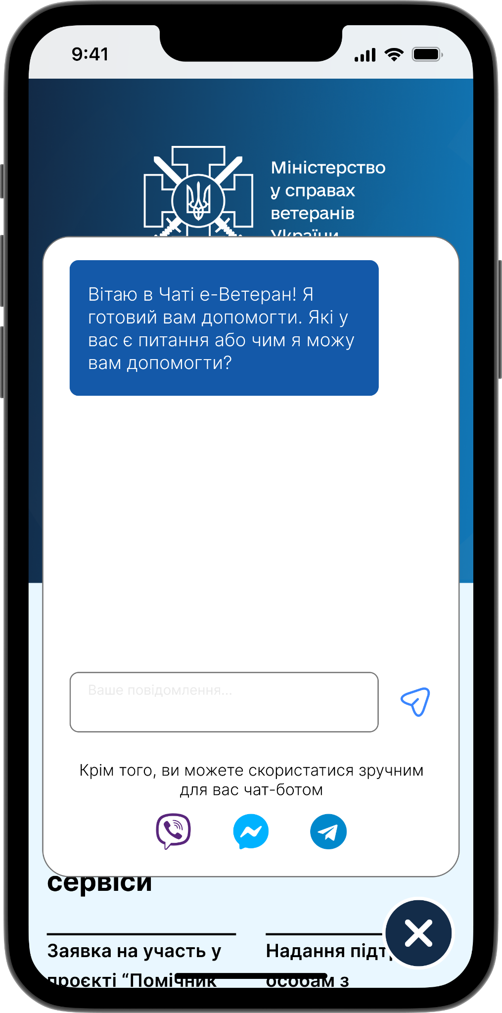
User Flow (user flow from button to chat)

Slide 13
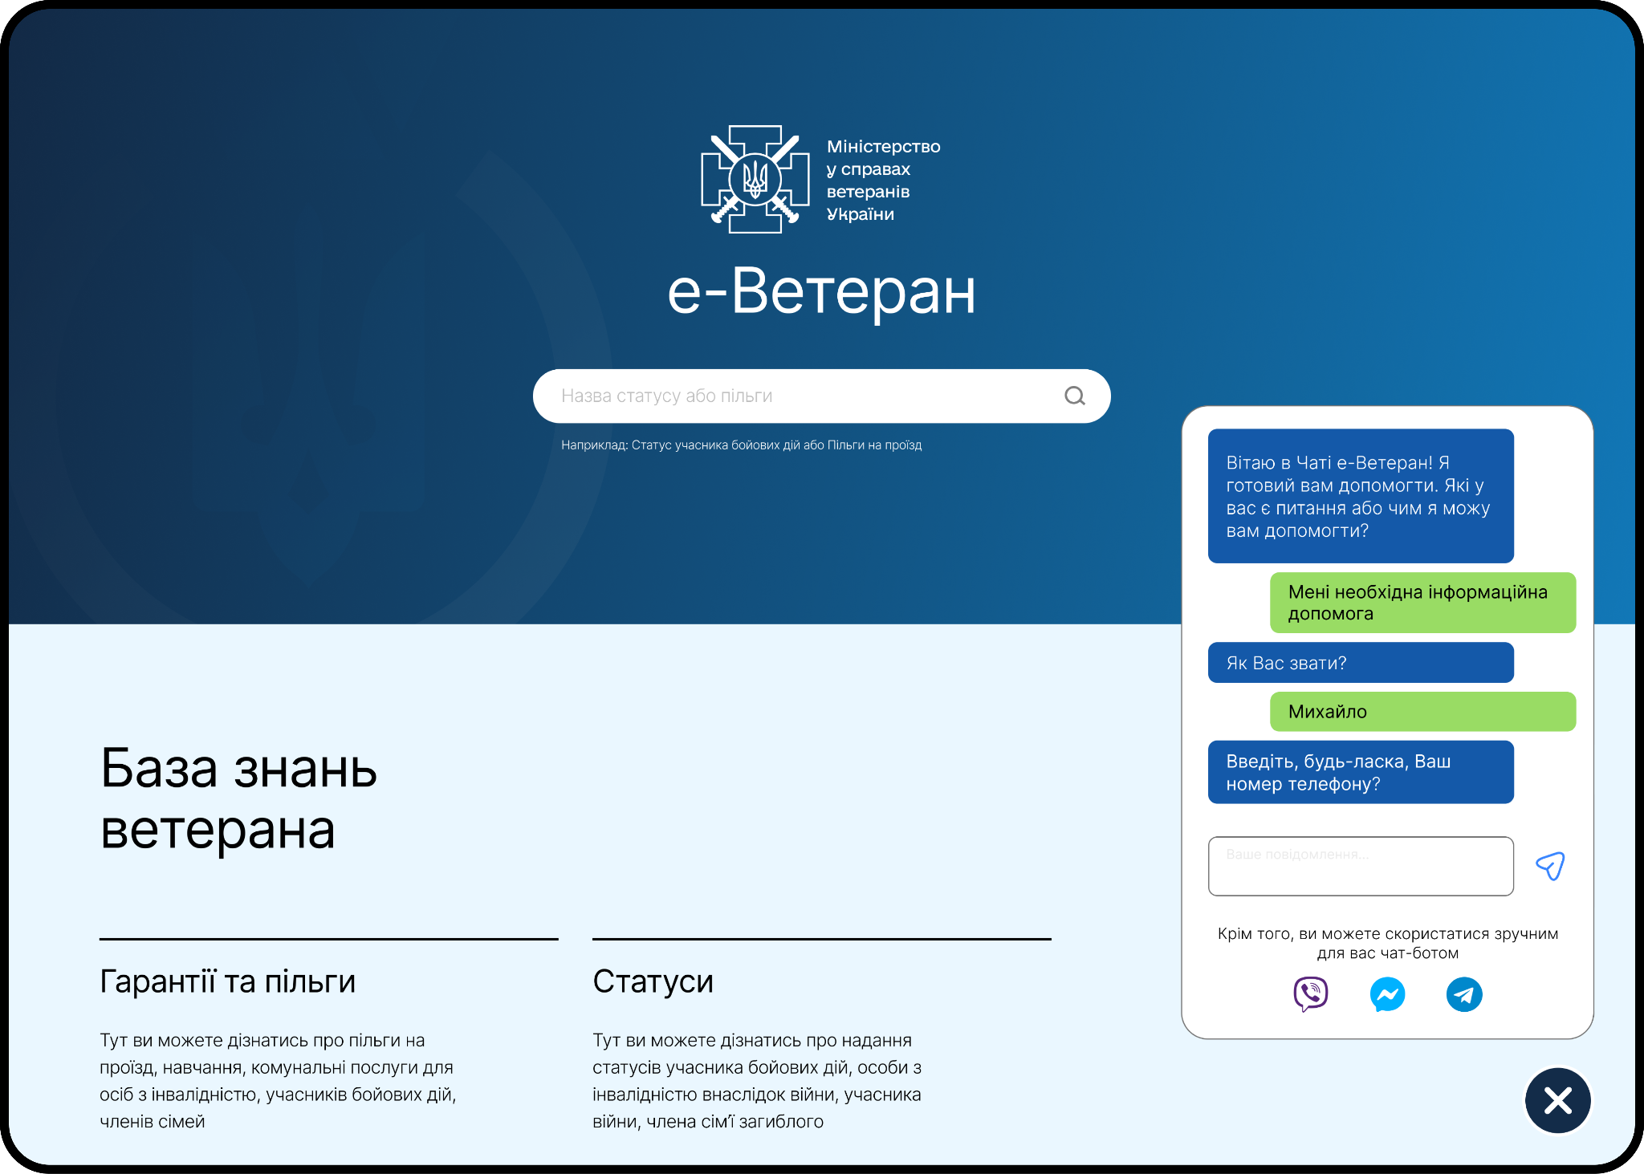
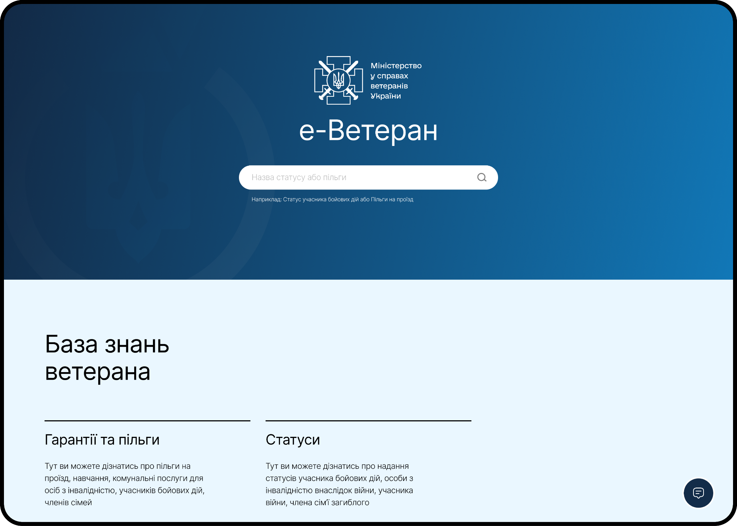
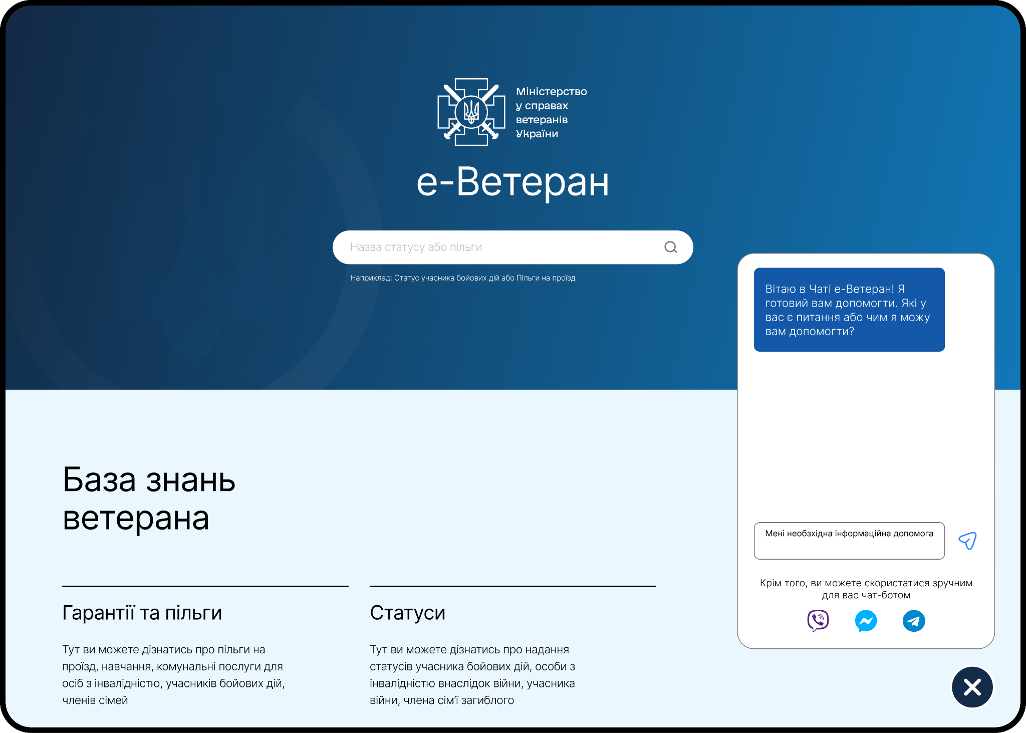
User Flow (user flow from button to chat)

Slide 14
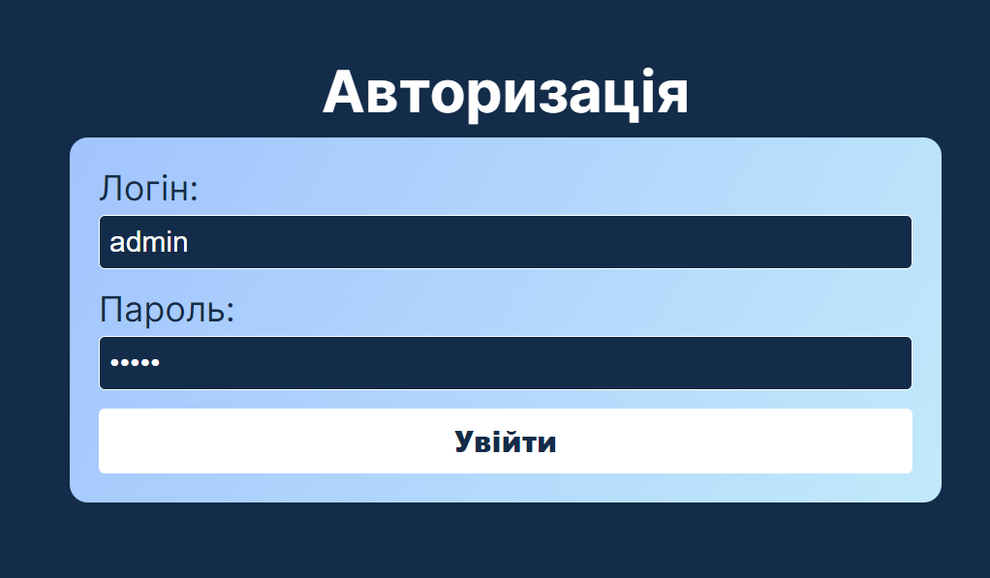
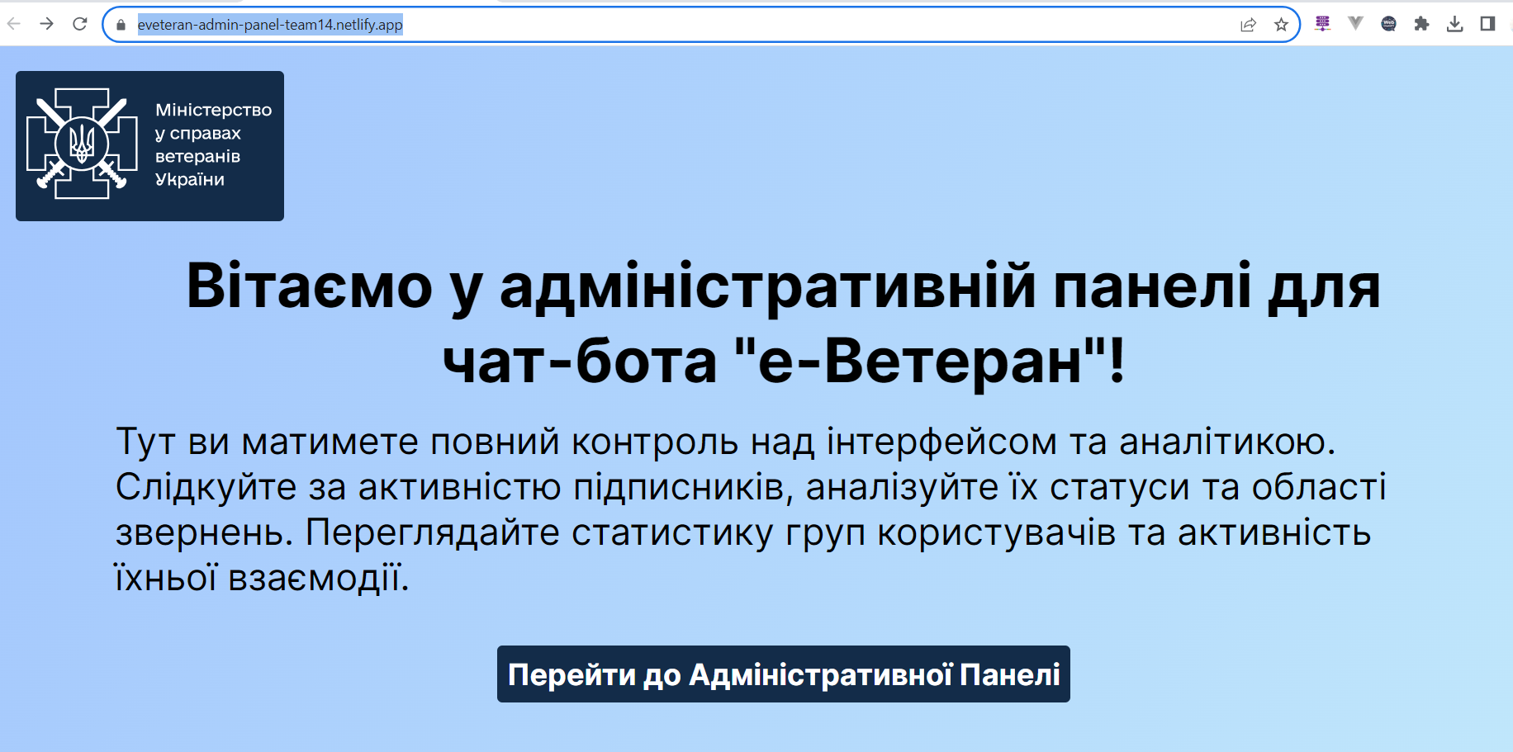
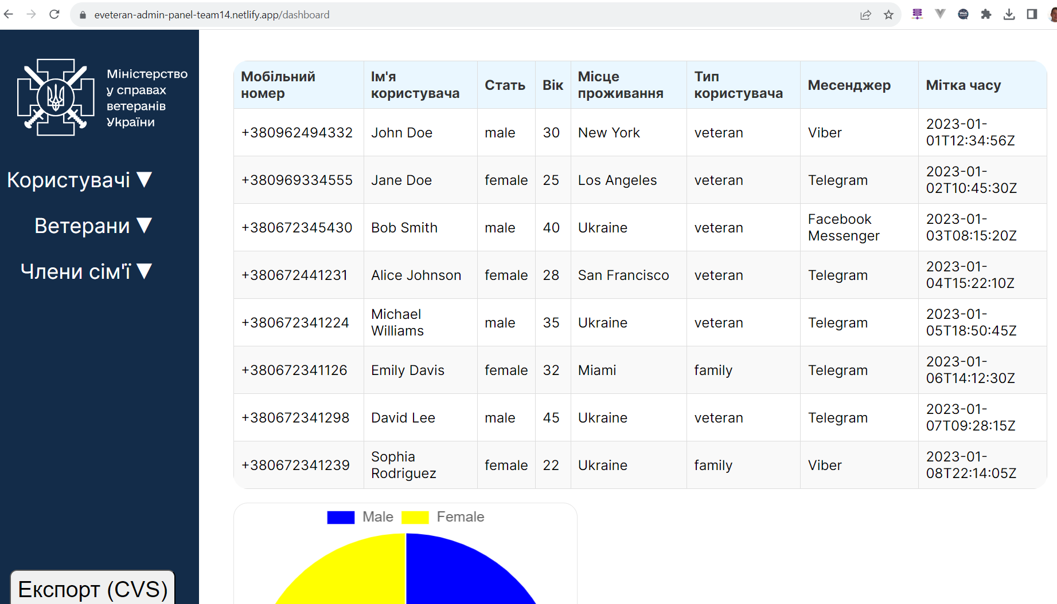
UI/UX OVERVIEW
ADMIN PANEL - deployed on Netlify
https://eveteran-admin-panel-team14.netlify.app/
Credentials - admin/admin
GitHub - https://github.com/kolibri753/eVeteran_chatbot_admin-panel
Notes:
1. Аналіз підписників за типом статуса у звернені:
Фіксування кількості усього звернень.
Відстеження кількості юзерів по областям.
Відстеження кількості найчастіших питань.
2. Аналіз груп користувачів:
Відстеження кількості користувачів в кожній з утворених адміном груп.
3. Відстеження активності користувачів (відвідуваність) за обраним періодом.
Сегментація користувачів за періодами активності, такими як 7 днів, 14 днів, 21 день, 1 раз в місяць, 1 раз в три місяці,.
Фіксування активності користувачів (наприклад, кількість відвідувань) виходячи з обраного періоду.
Варіації аналітичних запитів:
Адміністратор повинен мати можливість обирати період для аналізу та групувати дані відповідно до зазначених параметрів, таким чином:
Відстеження кількості відправлених порад за період (наприклад, за тиждень, місяць, рік) з вказанням типу поради та месенджера.
Відстеження кількості відкритих порад за період з розподілом за типом месенджера та типом поради.
Аналіз активності користувачів в розрізі періодів та видів месенджерів.
Аналіз активності користувачів в розрізі періодів та видів месенджерів.
Ці аналітичні дані повинні бути доступні адміністраторам через інтерфейс адміністративної панелі та можуть бути експортовані в ексель-файл для подальшого аналізу.

Slide 15
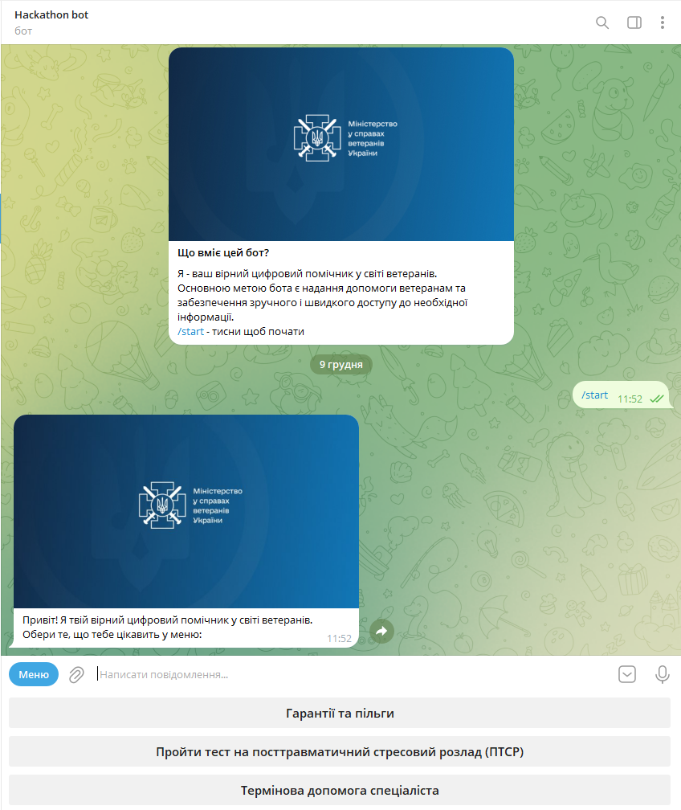
TELEGRAM BOT
MVP0 - PoC
Link - https://t.me/AVVAO_hackathon_bot
Main screen is available when first opened:
Available discussions: 1) Info about exemptions
2) Take a well-being test
3) Ask for urgent help of a specialist
—-------------------------------
Code of MVP0 is deployed to GitHub
https://github.com/dankozz1t/hackathon-bot

Slide 16
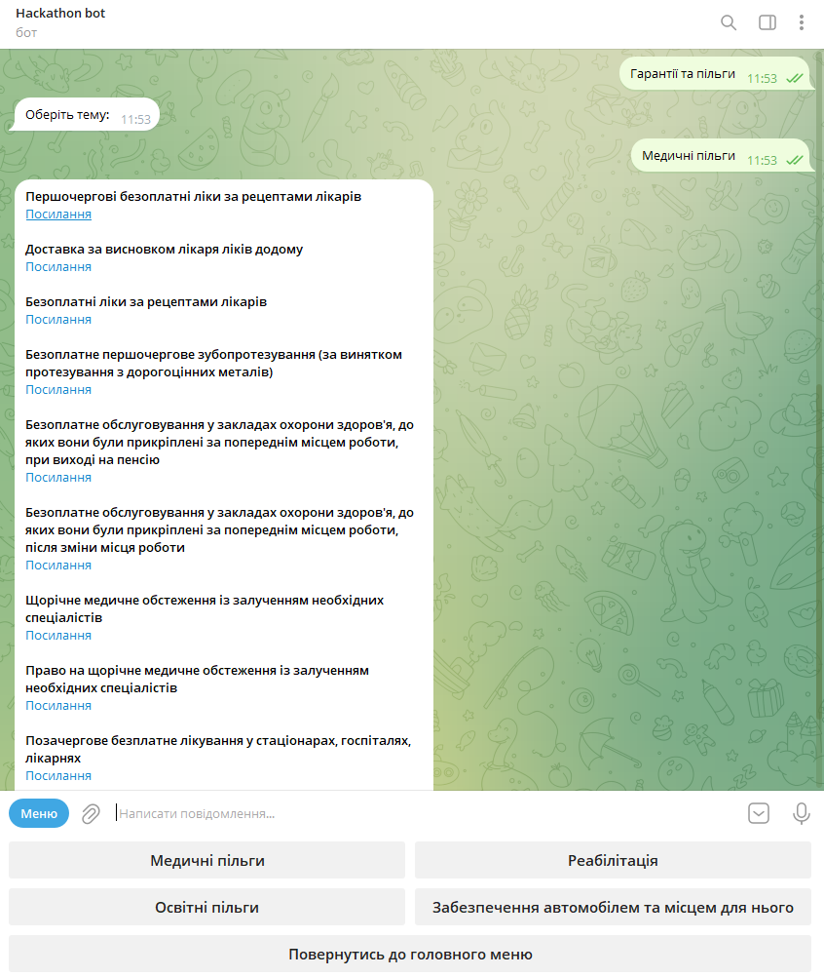
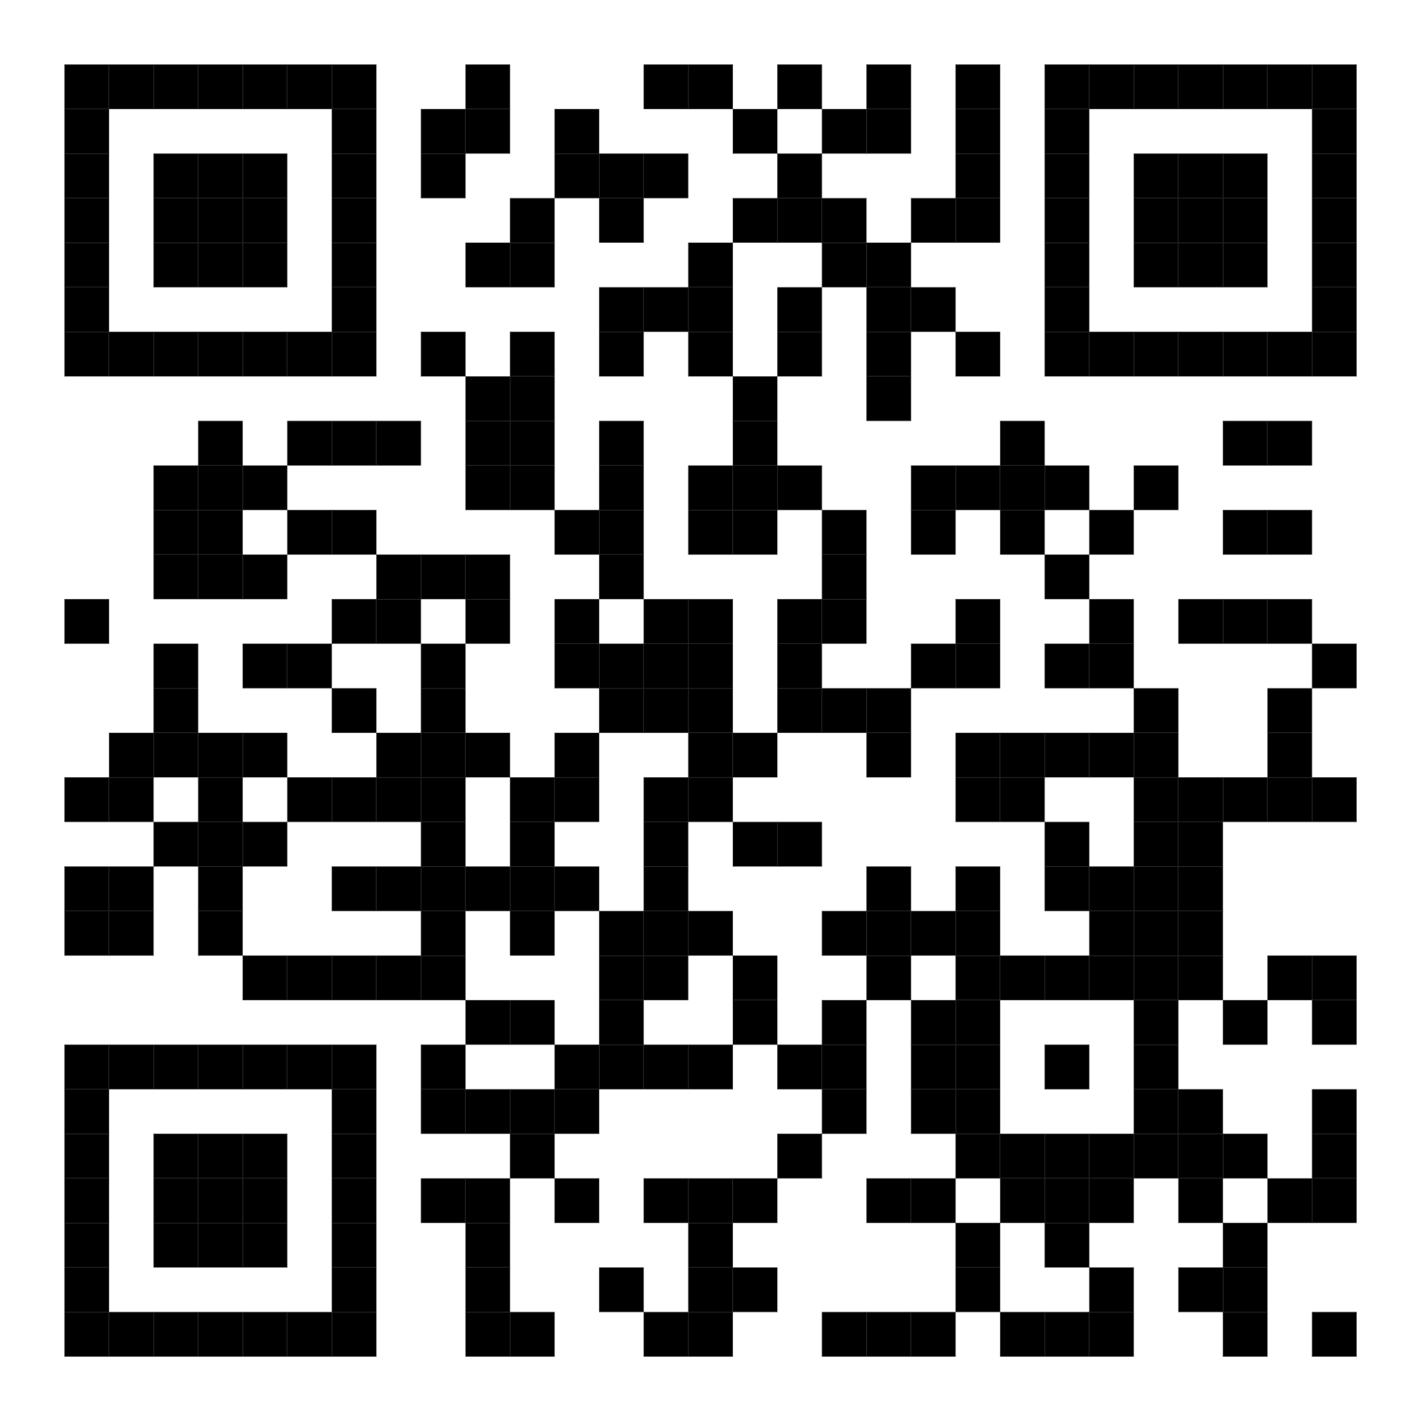
TELEGRAM BOT
MVP0 - PoC
An example of the discussion… Right now, you can test our bot! Scan this QR code

Slide 17
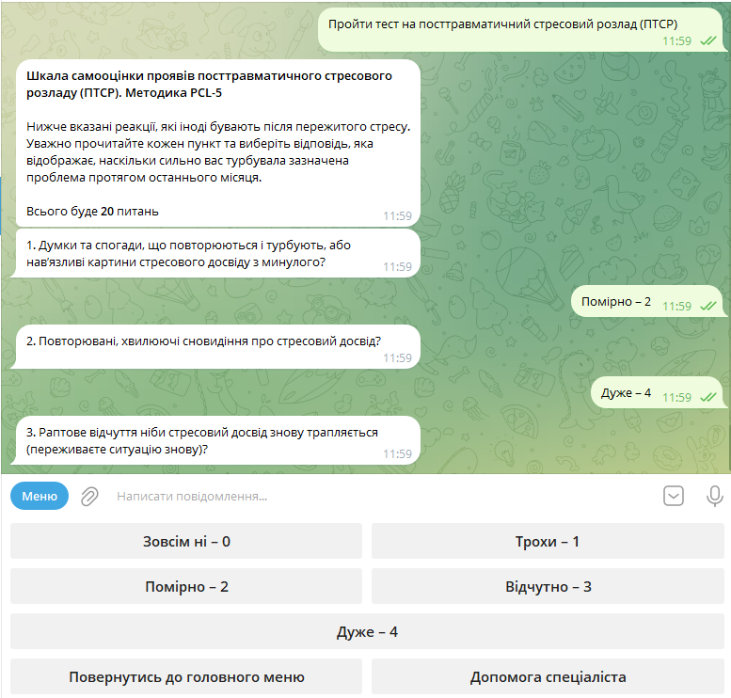
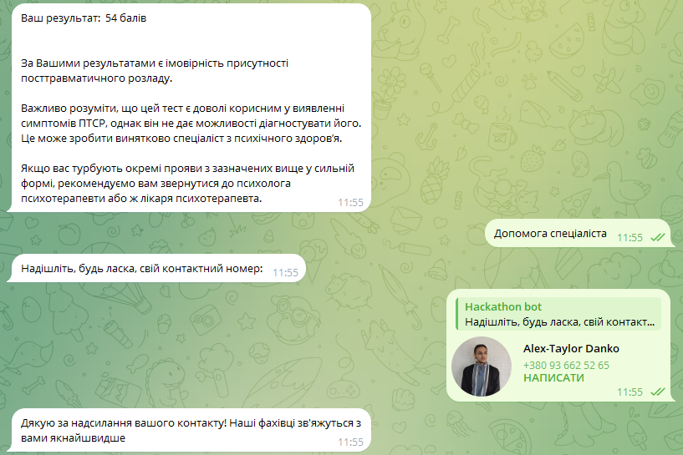
TELEGRAM BOT
MVP0 - PoC
Real test for the “Posttraumatic stress disorder (PTSD) self-assessment scale. PCL-5 methodology”.

Slide 18
SUMMARY
The solution to enable eVeteran website with the chatbot has been developed, including solutions architecture, UI/UX designs, user journeys for end-user and admin user.
MVP versions of working applications were deployed to the platforms:
Telegram bot (hosted locally on dev laptop)
https://t.me/AVVAO_hackathon_bot
https://github.com/dankozz1t/hackathon-bot
Admin panel (hosted on netlify.app)
https://eveteran-admin-panel-team14.netlify.app/
https://github.com/kolibri753/eVeteran_chatbot_admin-panel

Slide 19
THANK YOU
Vitalii Tymashkov (TL)
https://www.linkedin.com/in/vitaliy-tymashkov-en/
Alex-Taylor Danko (Dev FE+BE)
https://www.linkedin.com/in/dankozz1/
Oleksandra Skliar (UI/UX)
https://www.linkedin.com/in/oleksandra-skliar/
Vira Vakhovska (UI/UX + FE)
https://www.linkedin.com/in/vira-vakhovska/

Slide 20
Q&A
Notes:
Технічні критерії
1. Легкість розгортання – 5 балів.
2. Легкість рішення – 5 балів.
3. Масштабованість рішення – 5 балів.
Функціональні критерії
4. Функціональність та працездатність адміністративної панелі – 5 балів.
5. Ефективність системи сегментації аудиторії – 5 балів.
6. Інтуїтивна зрозумілість інтерфейсу (адмінки?) Ми ще повинні продумати зрозумілість інтерфейсу чат-боту! – 5 балів.
7. Точність та повнота аналітичної інформації – 5 балів.
Додаткові бали
8. Розгорнутий проект – 10 балів. (якщо Алекс локально запустить - без БД?)
9. Креативні рішення та ідеї – 10 балів.
☝️ Максимальна кількість балів, яку може отримати команда – 55 балів.

Slide 21
EXTRA MATERIALS
FOR EXTENDED PRESENTATION
The materials provided below are not included in the hackathon’s video presentation because of time limitations.
They include task description, component diagram.

Slide 22
INTRO
After the victory, Ukraine will become a country in which approximately 4 million of our fellow citizens who have gained experience in combat operations, as well as members of veterans' families and families of fallen soldiers, will need special attention and care. During the brutal war, many of our Defenders lost their homes and jobs, their physical and mental health changed. And the state must create all conditions for their comfortable return to civilian life.
For this, based on the already existing demand in the country and known foreign experience, a new service (profession) for veterans and their family members was launched at the initiative of the Ministry of Veterans. The institute of the veteran's assistant is being introduced as part of the system of transition from military service to civilian life as part of territorial communities. The pilot project started on July 1, 2023 in the Lviv, Vinnytsia, Dnipropetrovsk and Mykolaiv regions. On October 10, 2023, Zakarpattia, Kyiv, Sumy, Poltava, Kharkiv regions and the city of Kyiv joined these regions.

Slide 23
NEED TO BE DONE
The project was created without the participation of a support chatbot.
In this regard, the Ministry was faced with a number of problems that create obstacles for effective communication with candidates for the position of veteran's assistant.
The main feature of the bot is that it has a basic question-answer logic, that is, when a person goes to the eveteran.gov.ua website and chooses services to apply for participation in the "Veteran's Assistant" project, the bot informs him in the corner of the screen that a person can ask a question and get typical answers to typical questions, or leave your phone number and the number of your application to find out the status of the application.
The bot must have an admin to collect information and respond.
Another no less basic aspect of the bot is the collection of analytics. What are the most frequent questions, from which areas are the most questions asked, age, etc.

Slide 24
PROBLEM
REQUIREMENTS FOR ADMIN
The goal of this project is to develop an "e-Veteran" chat bot that will allow administrators to create groups of users and sort information by area, add new questions and answers, manage application status notifications, and also receive analytical information about users. The "e-Veteran" chat bot should be a digital version of a veteran's assistant, with the possibility of applying for participation in the "Veteran's Assistant" project.
The chat bot must function in: Telegram, Viber, additionally - Messenger.
1. Creation and management of user segments
Ability to create user segments based on the following criteria:
All users
veterans
Family members
Age
Geographical localization
Request registration time
According to users, how many typical questions were answered
According to users, how many appeals were received by the administrator

Slide 25
PROBLEM
REQUIREMENTS FOR ANALYTICS
2. Working with analytics
The administrative panel for the "e-Veteran" chatbot should also include the following analytical functions for collecting and displaying information:
1. Analysis of subscribers by type of status in the addressed:
Fixing the number of all appeals.
Tracking the number of users by region.
Tracking the number of most frequently asked questions.
2. Analysis of user groups:
Tracking the number of users in each of the groups created by the admin.
3. Tracking user activity (attendance) for the selected period.
Segmentation of users by activity periods, such as 7 days, 14 days, 21 days, once a month, once every three months.
Recording user activity (for example, the number of visits) based on the selected period.

Slide 26
PROBLEM
REQUIREMENTS FOR ANALYTICS
Variations of analytical queries:
The administrator should be able to select the period for analysis and group the data according to the specified parameters, as follows:
Tracking the number of tips sent per period (eg, week, month, year) with tip type and messenger.
Tracking the number of open tips per period, broken down by messenger type and tip type.
Analysis of user activity in terms of periods and types of messengers.
Analysis of user activity in terms of periods and types of messengers.
This analytical data should be available to administrators through the administrative panel interface and can be exported to an excel file for further analysis.

Slide 27
PROBLEM
REQUIREMENTS FOR CREATIVE IDEAS
3. Creative solutions and ideas
Since the chat bot is being developed from scratch, teams have the opportunity to offer their own version and ideas for the interaction of the chat bot with the target audience.
Analyze the CA, determine the Tone of Voice, think about what functionality a chat bot can have, for example:
Convenient authentication and registration.
Providing information about treatment, medical facilities, psychological support and legal assistance.
Answers to general questions veterans have about their rights and access to benefit programs.
Psychological support:
Using text recognition algorithms to provide psychological support through a chatbot.
Links to hotlines and the possibility of contacting a psychologist for consultations if necessary.
Sending notifications about new resources, support programs and events for veterans.
Ensuring the confidentiality of users' personal information.
☝️ The proposed ideas are not mandatory for implementation and may be changed, supplemented or expanded.

Slide 28
SOLUTION ARCHITECTURE
CLOSE THE GAP
Our product makes consumer lives easier, and no other product on the market offers the same features
TARGET AUDIENCE
Gen Z (18-25 years old)

Slide 29
SOLUTION ARCHITECTURE
CLOSE THE GAP
Our product makes consumer lives easier, and no other product on the market offers the same features
TARGET AUDIENCE
Gen Z (18-25 years old)

Slide 30
SOLUTION ARCHITECTURE
CLOSE THE GAP
Our product makes consumer lives easier, and no other product on the market offers the same features
TARGET AUDIENCE
Gen Z (18-25 years old)

